Slide 1
USB Spectrometer
Name:
UoG ID:
UESTC ID:
Notes:
Good afternoon, professors, my name is Shu Zhaolin. Today I am glad to be here to give a presentation about my final year project. The title of my project is USB spectrometer.

Slide 2
My Student ID
Notes:
Here is my student ID.

Slide 3
Index
Background
Hardware Design
Software Design
Building
Demonstration
Result
Conclusion
Notes:
And I will divide this presentation into these 7 sections.

Slide 4
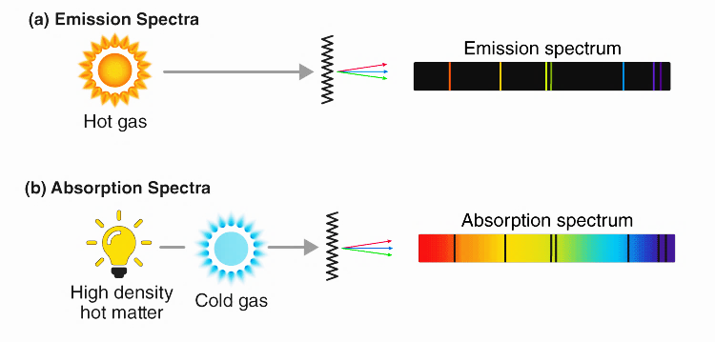
Background
Spectroscopy
Absorption and Emission Spectrum
Notes:
The first thing that I want to illustrate is the meaning of this project. There is a subject called spectroscopy, as we know each chemical element will radiate its unique wavelength of light and absolving the corresponding light. The spectroscopy is the science that use this properties of matter to measure and analysis the chemical composition of the material.

Slide 5

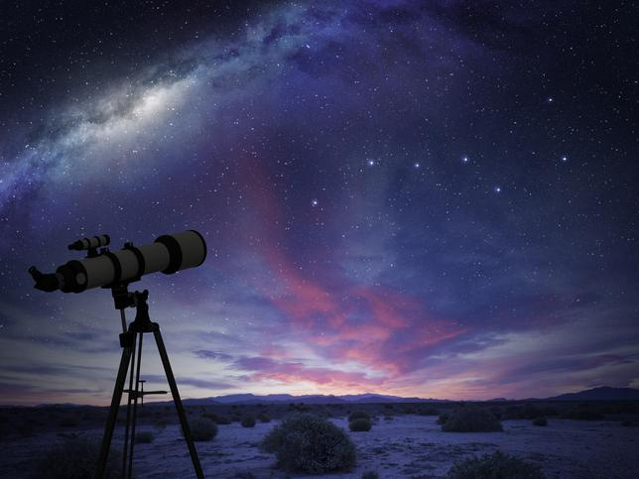
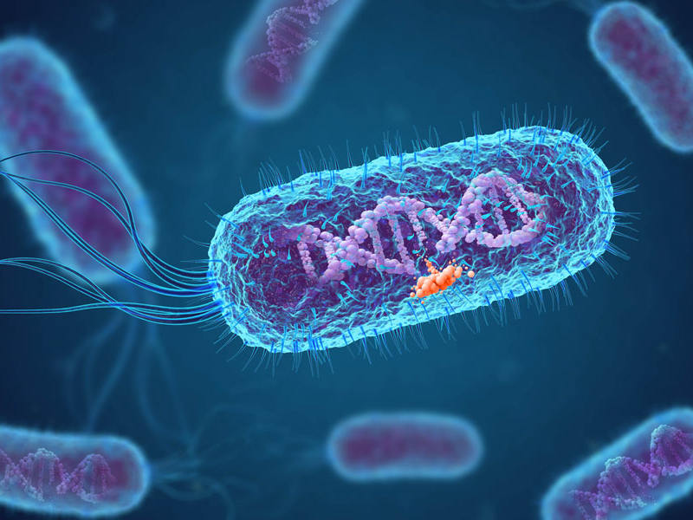
Background
Spectroscopy
Application
Chemistry
Astronomy
Biology
Notes:
For this reason, it has wide application in the areas like chemistry astronomy biology and so on. And an optical spectrometer become an essential equipment in these research field.

Slide 6
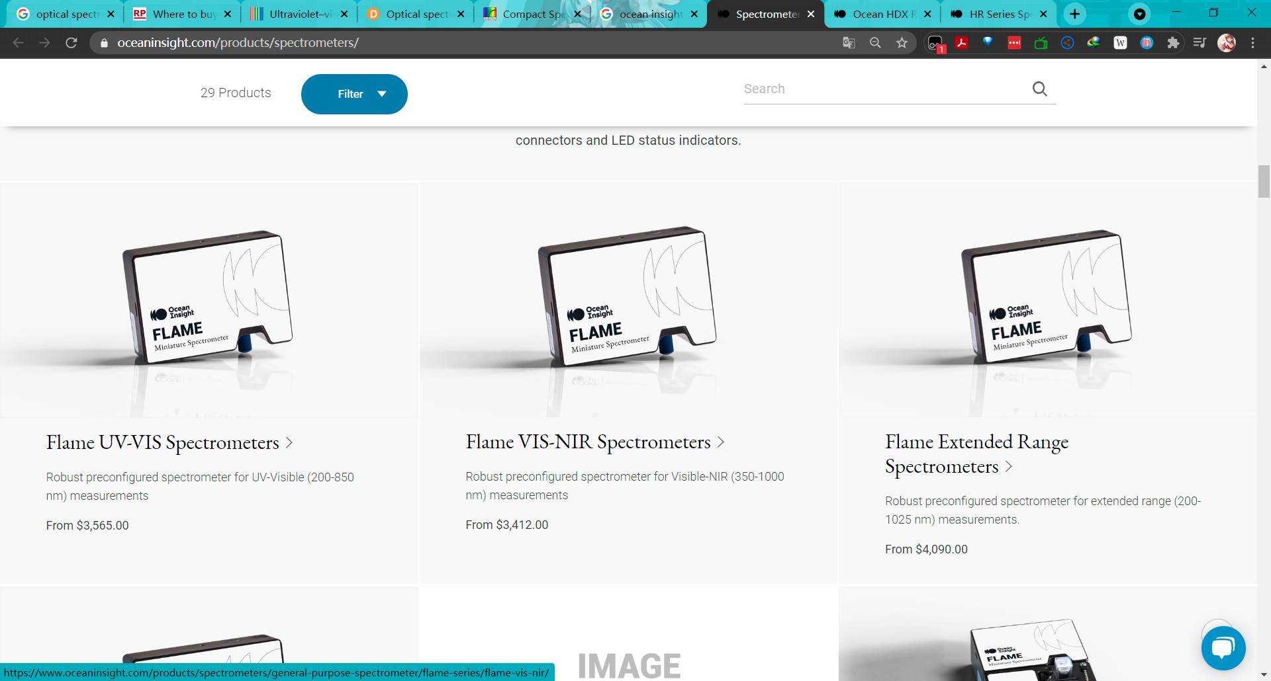
Background
Optical Spectrometer
Commercial Solution:
Extremely High Price (Thousands of Dollars)
Notes:
However, an optical spectrometer is usually extremely expensive. For just an entry-level product, the commercial solution may cost more than thousands of dollars, which is not acceptable for the poor laboratory and the science enthusiasts.

Slide 7
Background
Optical Spectrometer
Current DIY Solution
Low Cost
Low Resolution
Low Accuracy
No Compatible Software
Notes:
So that a DIY solution is necessary. But the current DIY spectrometer that I found online can not satisfied the research requirement. Although, the cost is usually very low, they also don’t have good resolution, the accuracy is not good, and they don’t have a compatible software for the data analysis.

Slide 8
Background
Optical Spectrometer
Design Goal
Less than 1 nm resolution
Wide Wavelength Range (400-1000 nm)
Less than 2000 CNY of cost
Easy-to-use software
Opensource all code, 3D models, and other material
Notes:
So that I realized that to build a high quality and low-cost spectrometer as the instruction is very useable for the future researchers. My design goal is to made an optical spectrometer that has less than 1 nm resolution, has wide wavelength range from 400 to 1000 nm, the total cost should be less than 2000 CNY and come with an easy-to-use software. And I will opensource all the material of this project online for anyone to building their spectrometers.

Slide 9
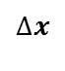
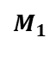
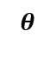
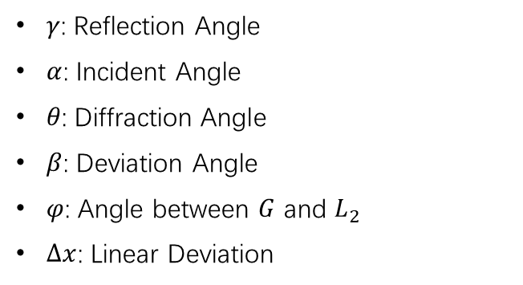
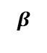
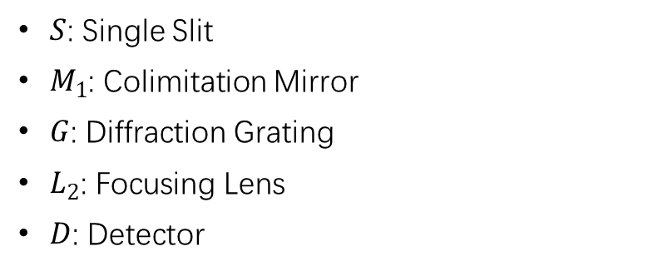
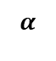
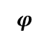
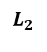
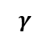
Hardware Design
Czerny–Turner spectrometer
$$M_{1}$$
$S$: Single Slit
$M_{1}$: Colimitation Mirror
$G$: Diffraction Grating
$L_{2}$: Focusing Lens
$D$: Detector
S
$$γ$$
G
$$α$$
$γ$: Reflection Angle
$α$: Incident Angle
$θ\text{: }\text{Diffraction} \text{Angle}$
$β$: Deviation Angle
$φ$: Angle between $G$ and $L_{2}$
$∆x$: Linear Deviation
$$L_{2}$$
$$β$$
D
$$θ$$
$$∆x$$
$$φ$$
Notes:
Then is hardware design part. For the structure of the spectrometer, I chose a widely used one called Czerny–Turner 切尔尼·特纳 spectrometer design. The structure is on the left side of the slide, it has 5 major components, which are …

Slide 10
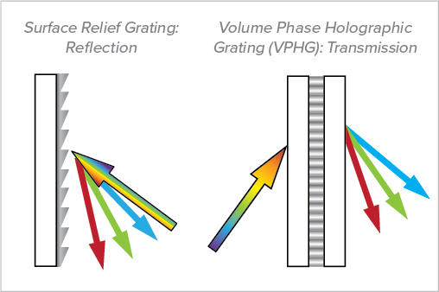
Hardware Design
Diffraction Grating
Periodic Structure
Reflected Grating [1]
Transparent Grating [1]
Notes:
And then, the most important comment is the diffraction grating, there are two basic type of grating, reflected one and transparent one. The principle behind them are similar, they both have periodic structure on the surface. And when light path through these structures, the different light components will be separate and causing chromatic dispersion.

Slide 11

Hardware Design
Diffraction Grating
$$I=A^{2}={C^{′}}^{2}a^{2}\frac{\sin^{2}{u}}{u^{2}}\frac{\sin^{2}{Nv}}{\sin^{2}{v} }$$
Where $u=\frac{πasinθ}{λ}$, and $v=\frac{\left[π\left(a+b\right)sinθ\right]}{λ}$.
Grating Equation:
$$d\left(sinφ±sinθ\right)=kλ$$
Notes:
After some mathematical derivation, we could get the k-th order peak distribution equation, and that is what called the grating equation. By using this equation, we could be able to design the spectrometer and choose the optimized parameter for it.

Slide 12
Hardware Design
System Resolution
Imaging resolution caused by the aperture diffraction limit
Chromatic resolution of the grating
The width of the slit’s image on the sensor
Sensor’s physical resolution.
Notes:
Another critical point for the design is the system resolution. It mainly depends on 4 parameter, which are aperture diffraction limit, grating chromatic resolution, the width of slit and the sensor’s physical resolution.

Slide 13
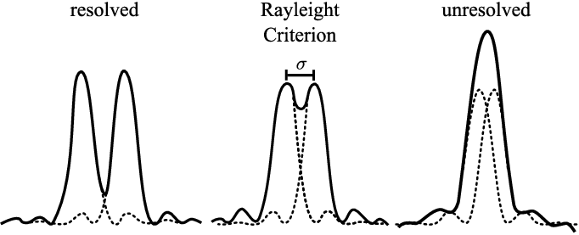
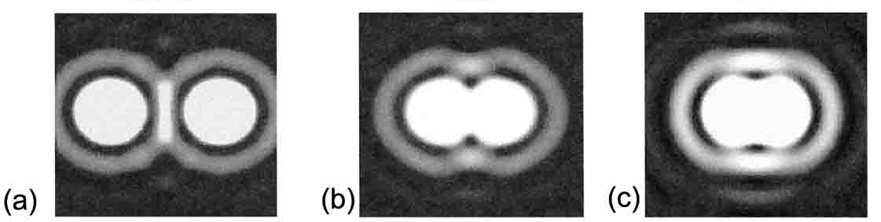

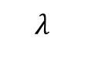
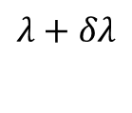
Hardware Design
Grating Chromatic Resolution
$$λ$$
$$λ+δλ$$
Demonstration for Rayleigh Criterion [4]
$$R=\frac{λ}{δλ}=Nk−1≈Nk$$
Notes:
Due to the time limit, here I only explain the most important one, which is the grating chromatic resolution.
As we know, the Rayleigh criterion describe the smallest angular difference between two light beam that can be resolved.
And it is the same for the grating chromatic dispersion, when two frequency component of light is too close, we could not distinguish them. And if we applied the Rayleigh criterion to the grating equation, we could get the grating chromatic resolution equation.

Slide 14
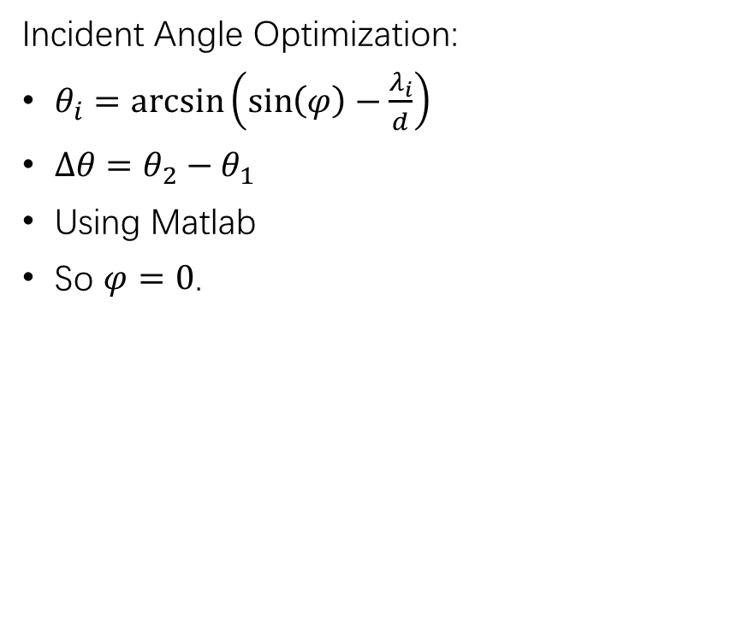
Hardware Design
Parameter Optimization
Incident Angle Optimization:
$θ_{i}=\arcsin\left(\sin\left(φ\right)−\frac{λ_{i}}{d}\right)$
$∆θ=θ_{2}−θ_{1}$
Using Matlab
So $φ=0$.
Notes:
After the theoretical design, we need to optimize the parameter in the spectrometer to gain the best performance. For example, to choose the optimized incident angle of the grating, we should firstly find the relationship between the incident angle and the diffraction angle difference. Then we use the Matlab to draw a diagram using this function. In the diagram, we could easily see when the incident angle is equal to zero, the diffraction angle difference will be maximum, so we choose zero as the optimized value of the incident angle.

Slide 15
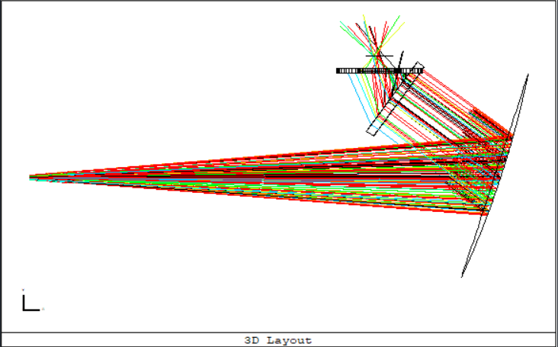
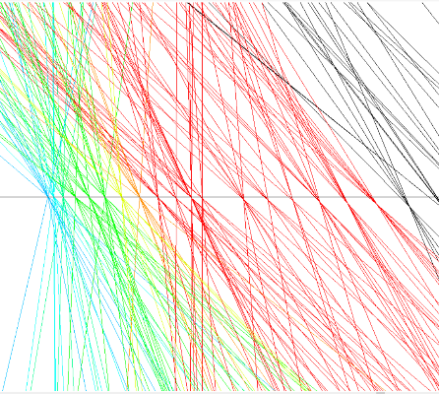
Hardware Design
Computer Simulation
Optical Simulation Software:
Zemax Optical Studio
Notes:
And after the designing processing, it is necessary to use software simulation to validate the design. In this case, I use an Zemax optical studio for simulation. I build the optical model in the software and using designed wavelength range to test it. In this graph, we could see all the frequency components are almost perfectly focusing on the detector, so the spectrometer has the ability to measure the designed wavelength range.

Slide 16
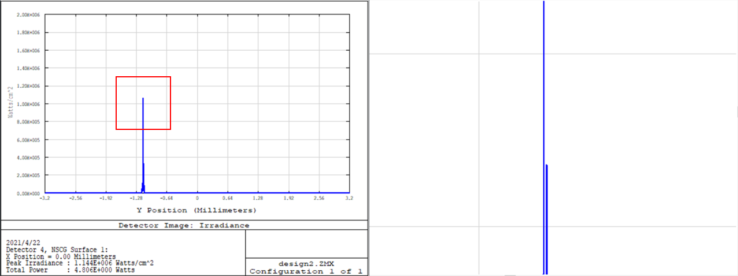
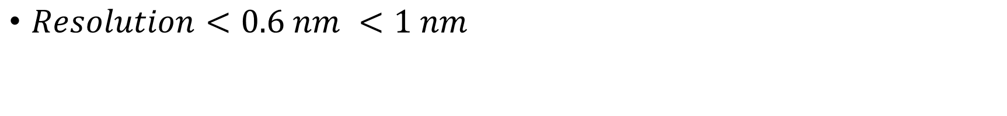
Hardware Design
Computer Simulation
D-lines of Sodium (588.9 and 589.5 nm)
$Resolution<0.6 nm <1 nm$
Notes:
And then, I use the famous yellow d-lines of the sodium emission spectrum to test the model. And we could clearly see two spike in the zoomed spectrum diagram.

Slide 17
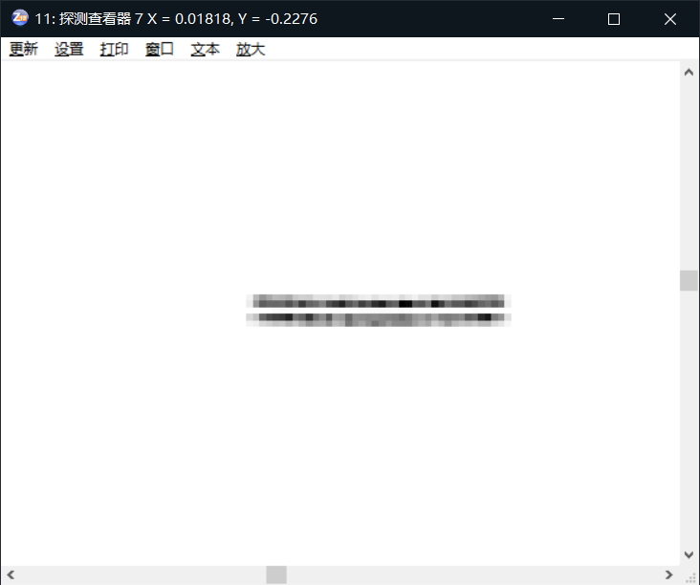
Hardware Design
Computer Simulation
D-lines of Sodium (588.9 and 589.5 nm)
$Resolution<0.6 nm <1 nm$
Notes:
Also, we could see the two spectra lines in the detector simulation graph. This indicates the spectrometer design has less than 0.6 nm of resolution, which is satisfied to the 1 nm design goal.

Slide 18

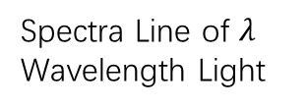
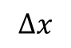
Software Design
Linear Dispersion
Using Imaging Formula and Grating Equation:
$$λ=d∗\frac{sinα+\sin\left(\frac{∆x}{F_{L_{2}}}−φ\right)}{k}$$
$$∆x$$
Spectra Line of $λ$ Wavelength Light
Notes:
After the hardware part, we come to the software design section. There are two key point, the first one is the linear dispersion. The spectra lines of different frequency component is not linearly distributed on the detector. So, in order to map the spectrum image to the corresponding wavelength, we need to find the distribution formula. And here it is.
However, due to the manufacture and assembling error, the parameter of the spectrometer might not be the same as the designed ones. So, we need to find ways to calibrated these errors.

Slide 19
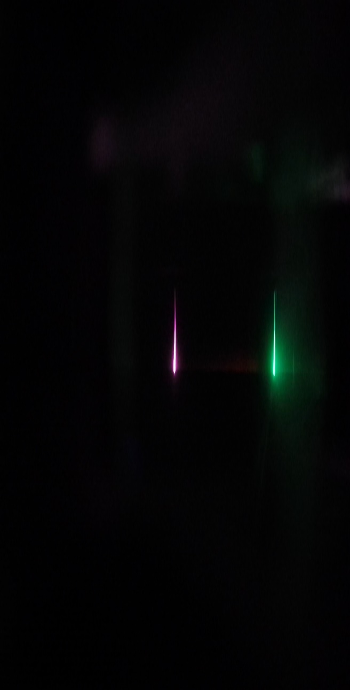
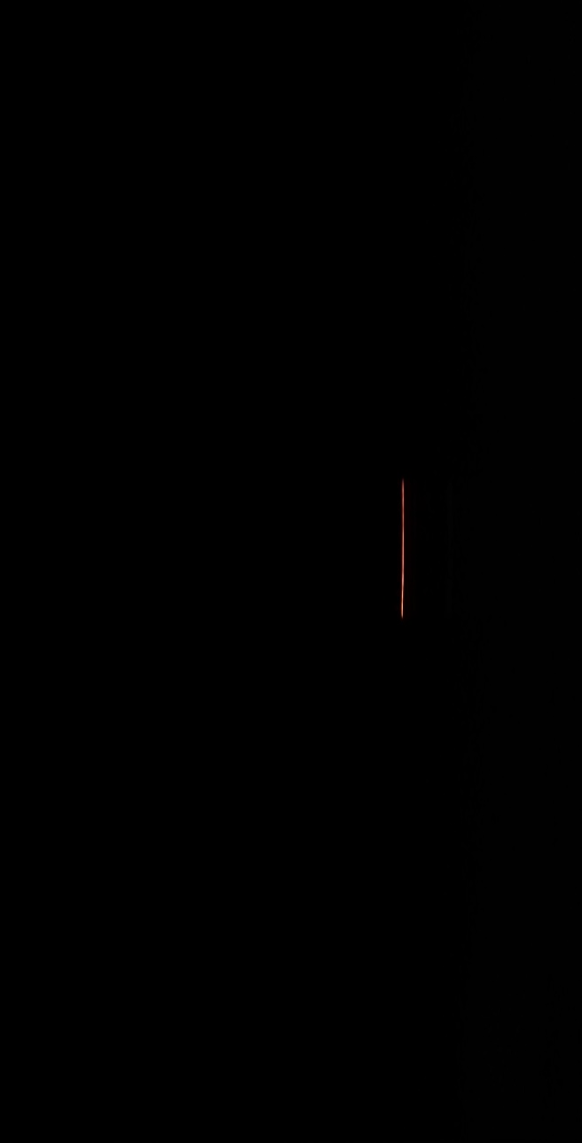
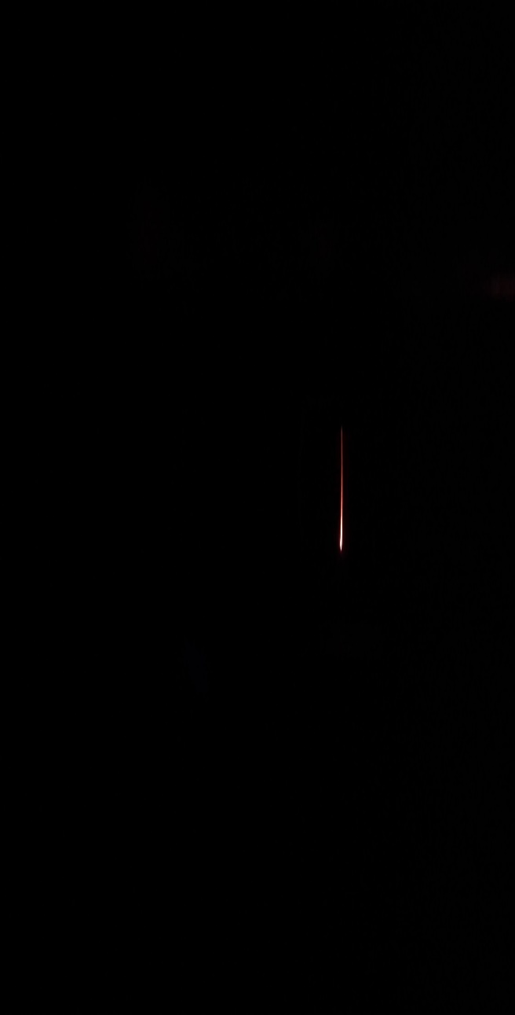
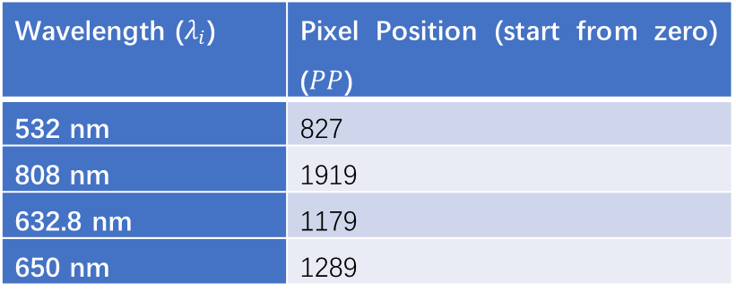
Software Design
Linear Calibration
Wavelength ($λ_{i}$) | Pixel Position (start from zero) ($PP$)
532 nm | 827
808 nm | 1919
632.8 nm | 1179
650 nm | 1289
3 lasers’ spectrum
Recorded Data
Using Estimation Algorithm
Notes:
So, I using three lasers to grape 4 groups of data. And by using some estimation algorithm, we could find the best possible parameters that is closest to the data we gained and calibrate the errors.

Slide 20
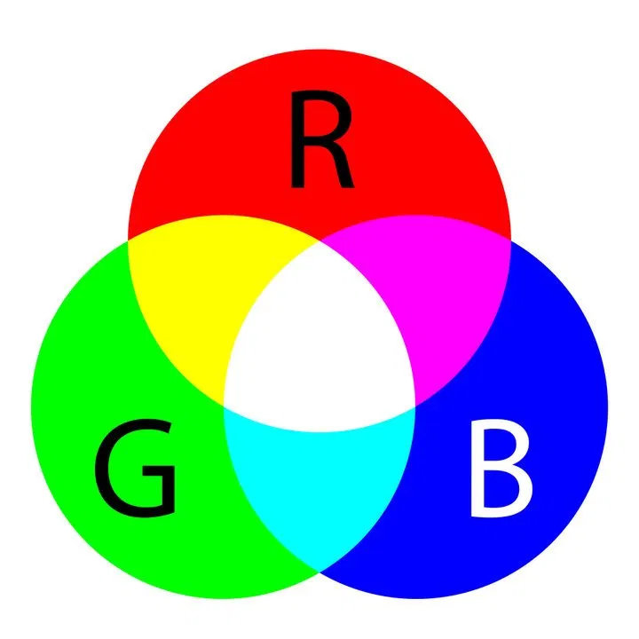
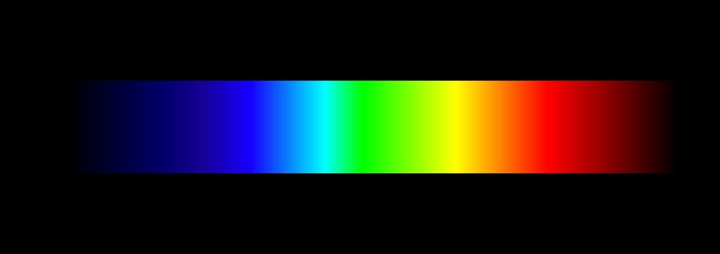
Software Design
Color Space
Mapping
Continuous Spectrum
RGB Color Space
Notes:
Another key point in the software design is the color space. As we know, the light spectrum is continuous, so it is very hard for computer system to process and store them. So that people invented a method to map the continuous spectrum to three independent vectors, usually red, green, and blue three color. And these vectors form a vector space, and that is what we called the color space.

Slide 21
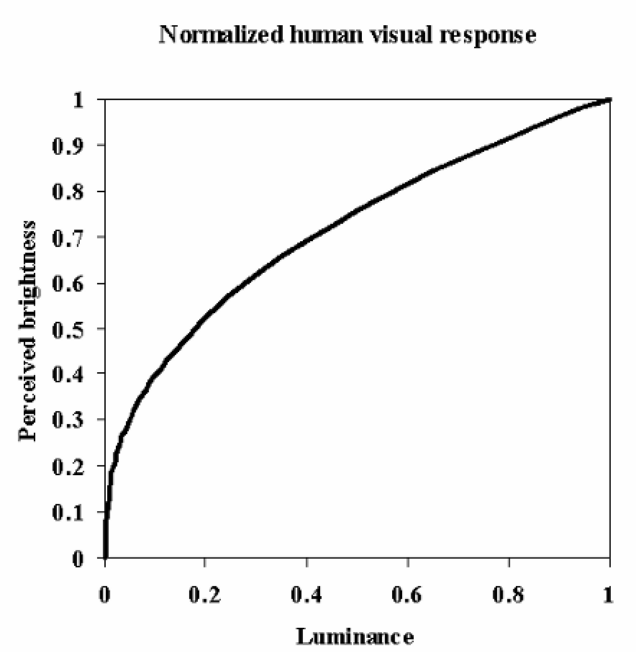
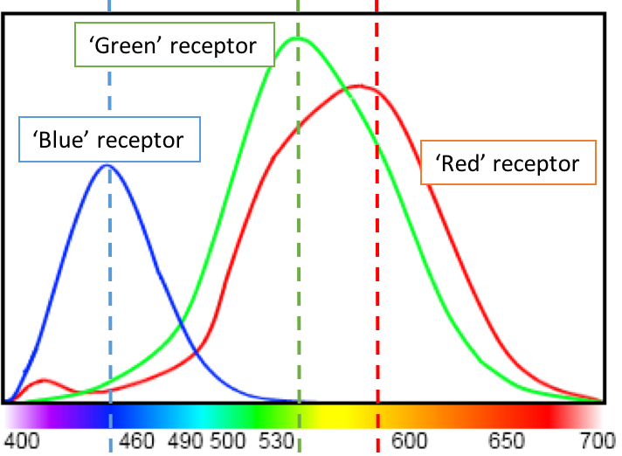
Software Design
sRGB Color Space
standard Red Green Blue (sRGB):
Design to match perceptions of human eyes
Sensitivity of Human Eyes [2]
Human Visual Brightness Response [3]
Notes:
And most computer and image system today use the standard RGB color space to store the brightness and chroma information. The sRGB color space is designed to match the linear perception of human eyes, but the human eyes do not have a linear response. So that the RGB three value that we get from the detector is not directly reflecting the luminance intensity, and we need to transform the sRGB color space to a linear one.

Slide 22
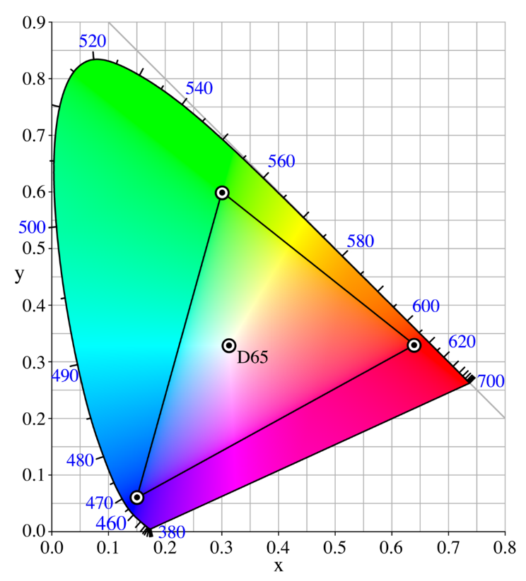

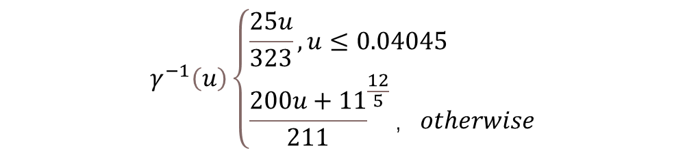
Software Design
CIE 1931 Color Space
$$γ^{−1}\left(u\right)\left\{\begin{aligned}&\frac{25u}{323},u≤0.04045 \\ &{\frac{200u+11}{211}}^{\frac{12}{5}}，otherwise\end{aligned}\right.$$
$$\left[\begin{matrix}X \\ Y \\ Z\end{matrix}\right]=\left[\begin{matrix}0.4124 & 0.3576 & 0.1805 \\ 0.2126 & 0.7152 & 0.0722 \\ 0.0193 & 0.1192 & 0.9505\end{matrix}\right]\left[\begin{matrix}R_{linear} \\ G_{linear} \\ B_{linear}\end{matrix}\right]$$
$$Y=Relative Luminance$$
Chromatic Graph of CIE 1931 [5]
Notes:
And the CIE 1931 color space is widely used linear color space standard. Similar to the sRGB, it also use three vectors to represent the chroma and luminance information, they are X, Y and Z, and the Y component is designed to directly represent the relative luminance. To transform the sRGB to CIE 1931, we need using the right two equations, then we get the XYZ vector.

Slide 23

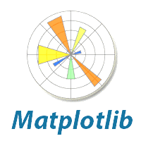


Software Design
Python3 and Opensource Libraries
Notes:
For the programming language, I choose Python 3 and I use many opensource libraries, like OpenCV, NumPy and Matplotlib. I choose this setup because they are widely used in many areas, so that there are a massive amount of instructions, documents and opensource code for them which greatly decrease the developing difficulty. And the most important reason is they are free to use, so that any potential user of my project will not need to pay an extra software license fee to use this spectrometer.

Slide 24
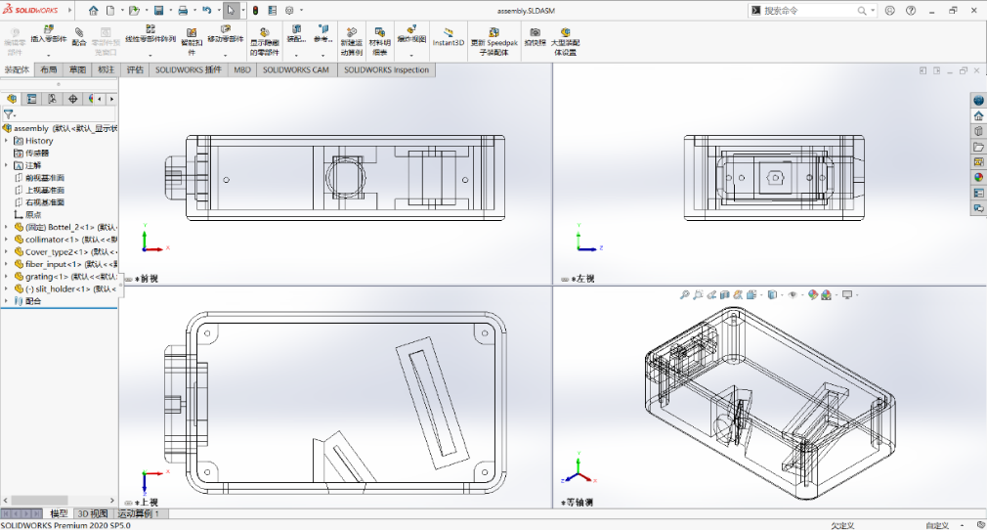
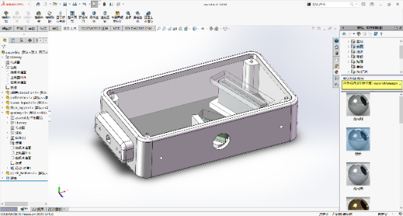
Hardware Building
3D Modeling
Notes:
After designing the hardware and software, we need to build the spectrometer in the reality. In this project, I use the SOLIDWORKS to build the 3D models of the outer case and other structure parts.

Slide 25
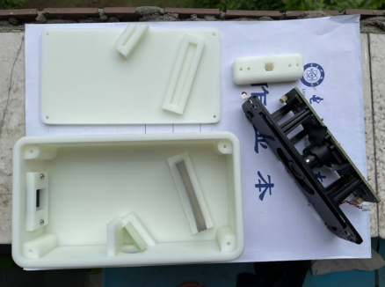
Hardware Building
3D Printing
Notes:
Then I sent the 3D model file to an online 3D printing manufacturer to do the 3D printing and sent the parts back to me.

Slide 26
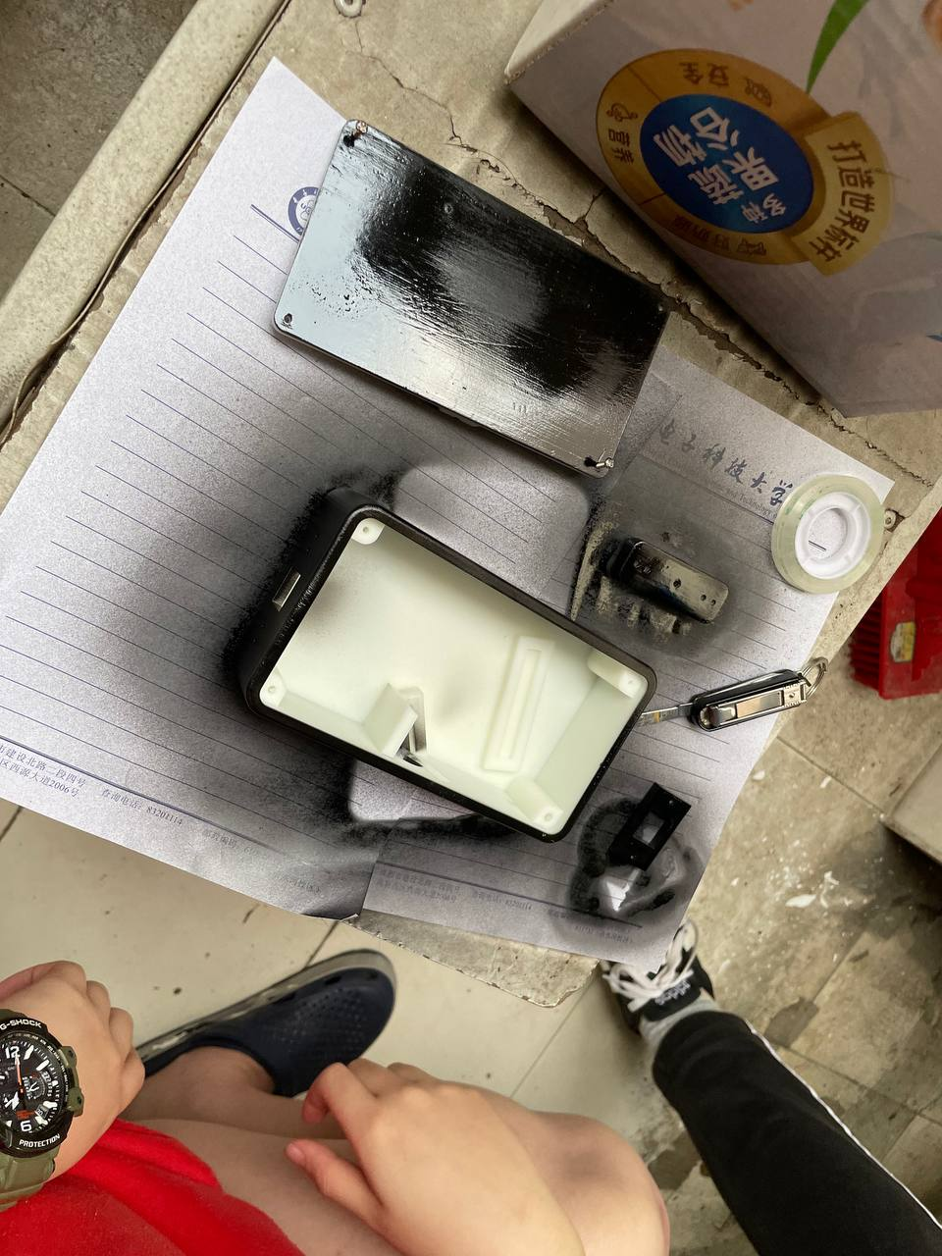
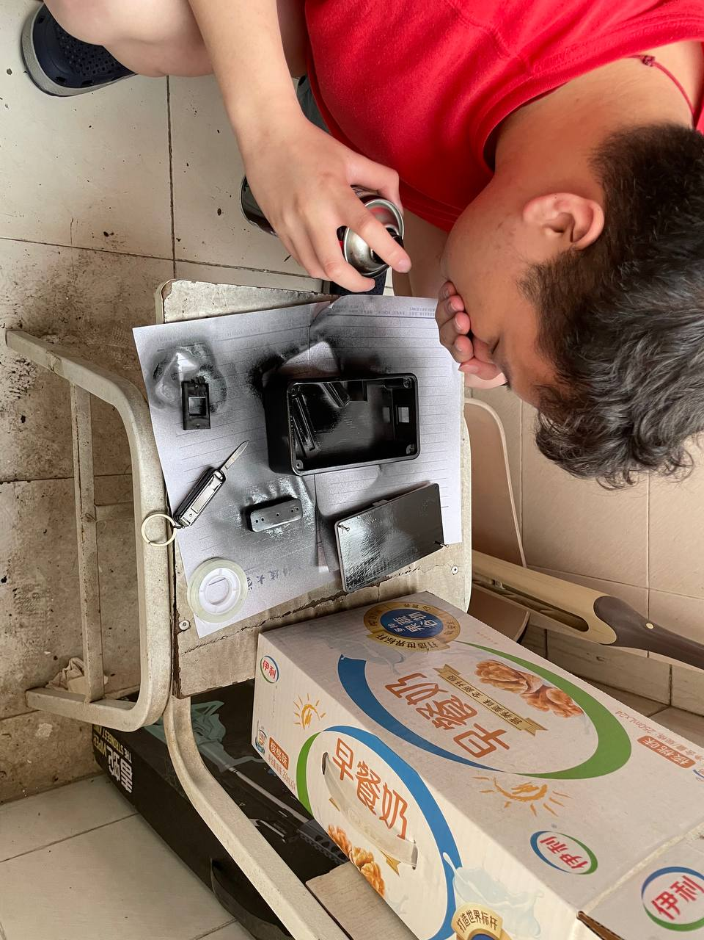
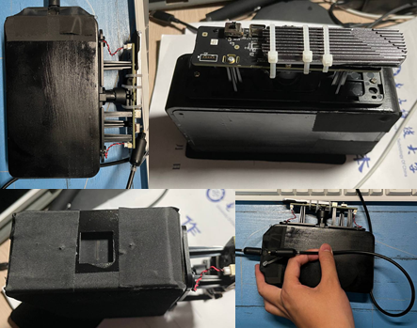
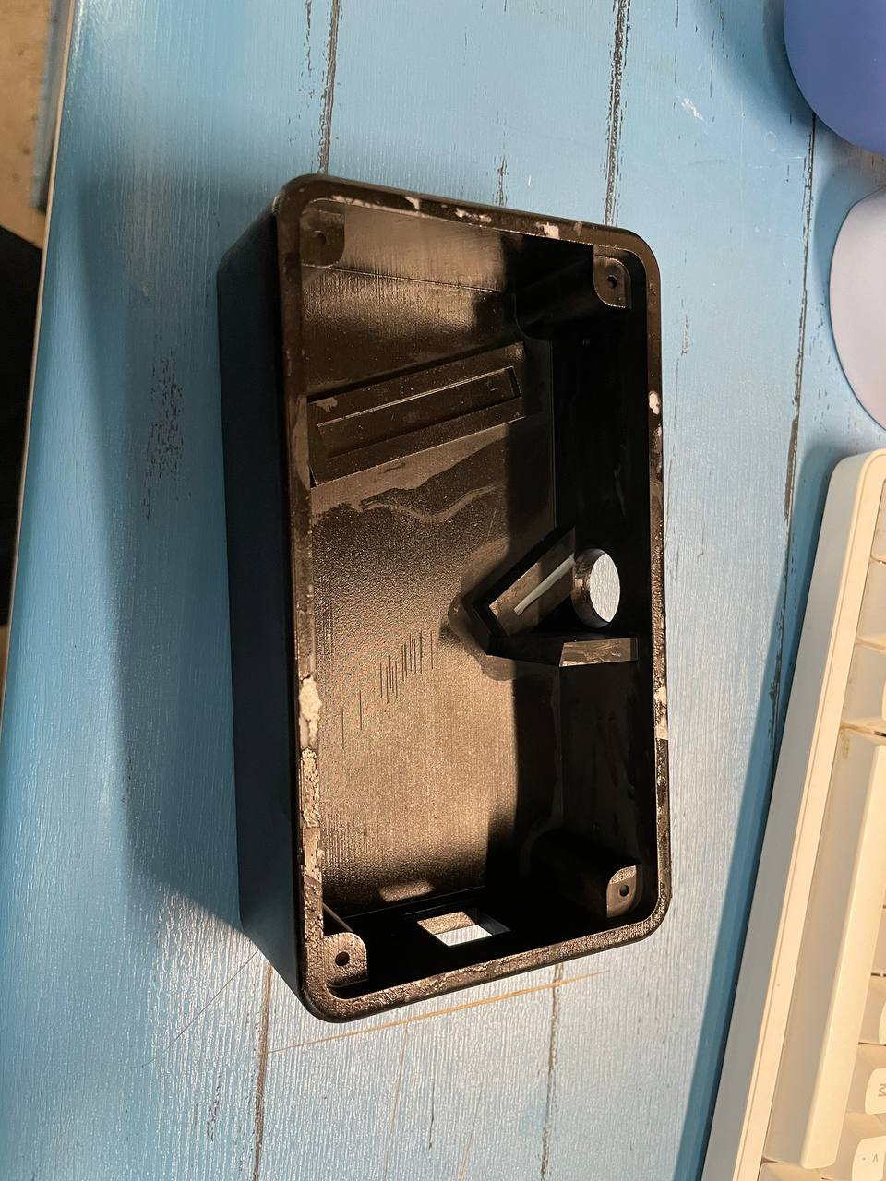
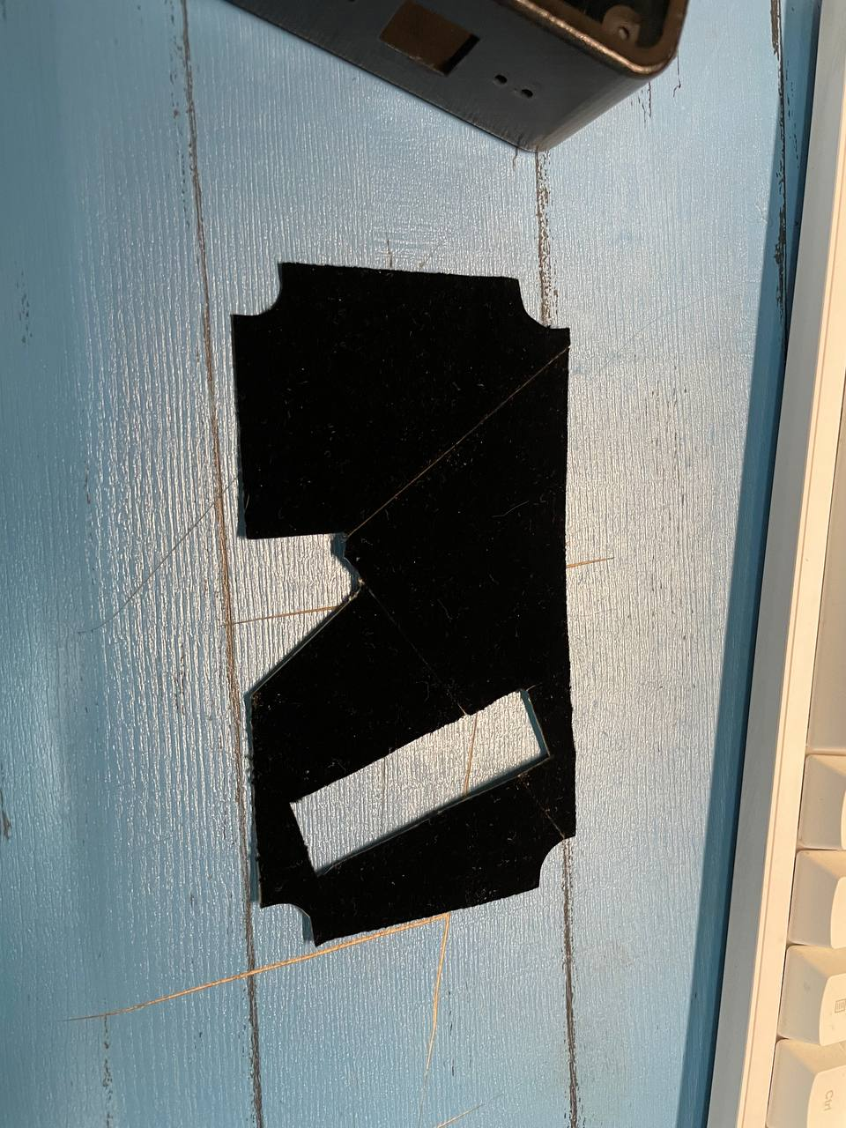
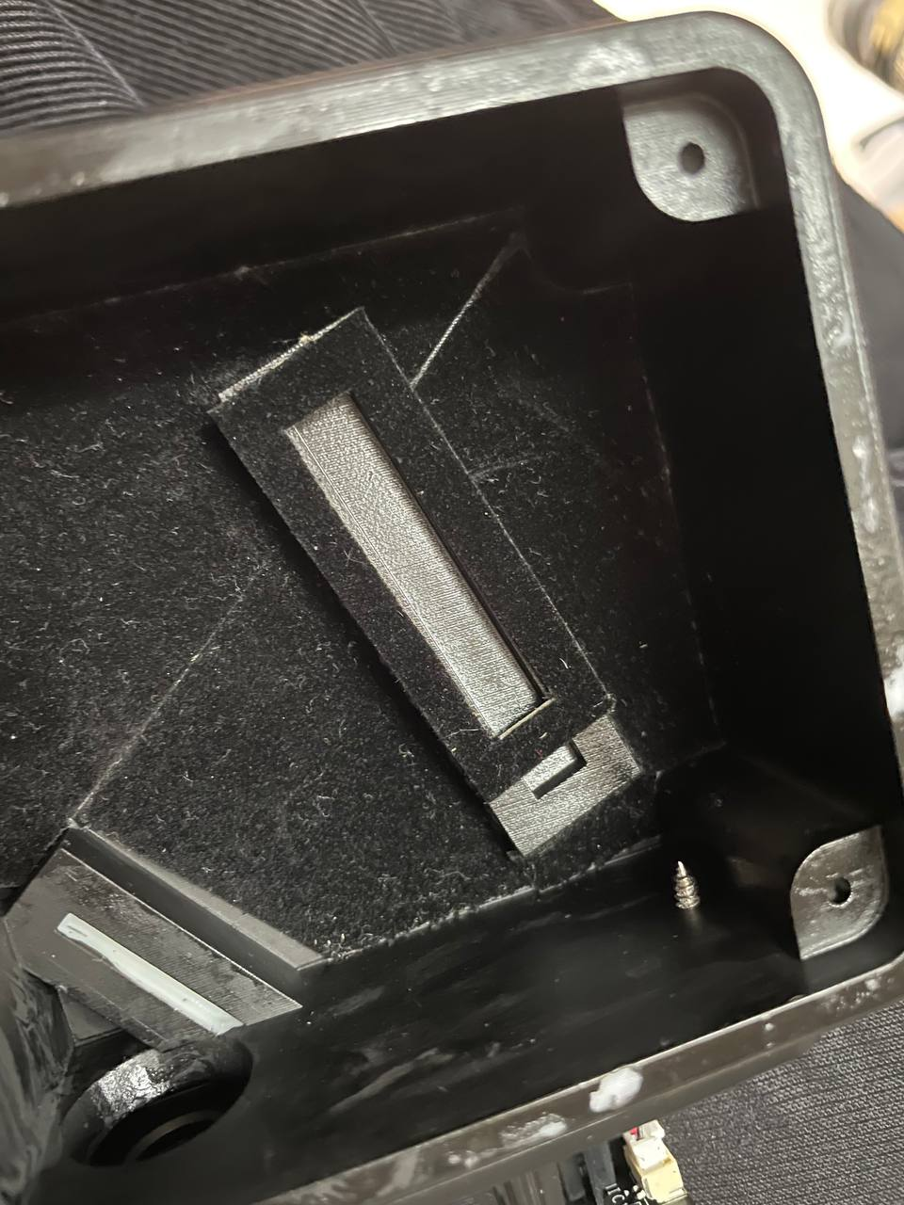
Hardware Building
Assembling
Notes:
Because the 3D printing material is white, I need to paint it with black paint and cover with light absorbing tape. And then I assembled the spectrometer with all parts.

Slide 27
Hardware Building
Total Cost
Name of component | Price with shipping fee (CNY)
Diffraction Grating | 165
Collimator Mirror | 105
Steel Single Slit | 125
Camera | 499
3D Printed Case | 285
Optical Fibre | 20
Lasers | 70
Overall | 1269
Notes:
The total material cost of this project is only about 1200 CNY, which is very cheep and satisfied the design goal.

Slide 28
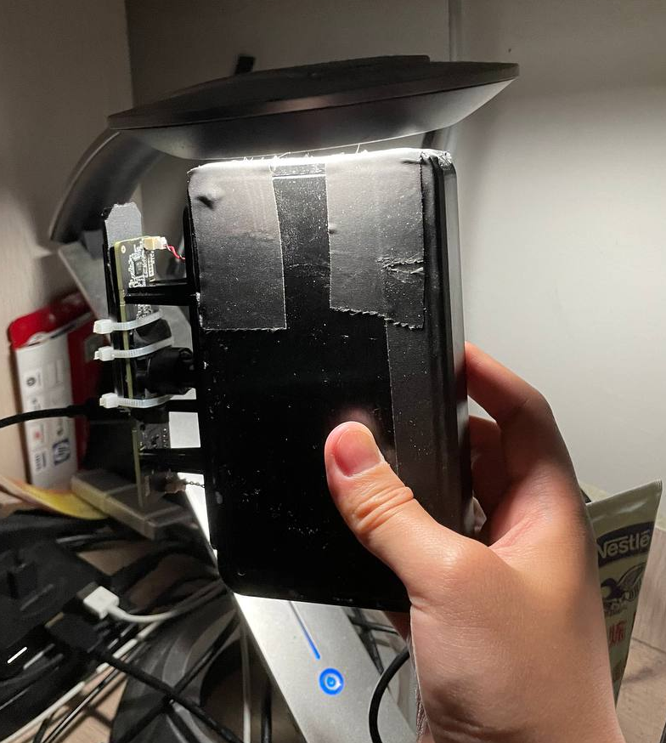
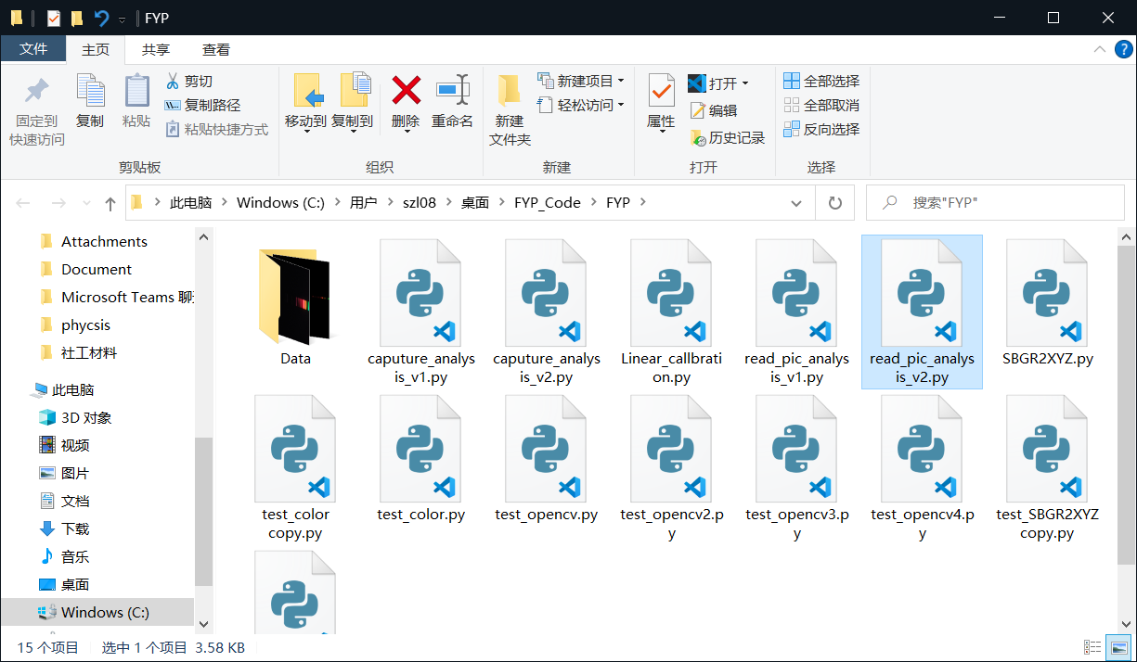
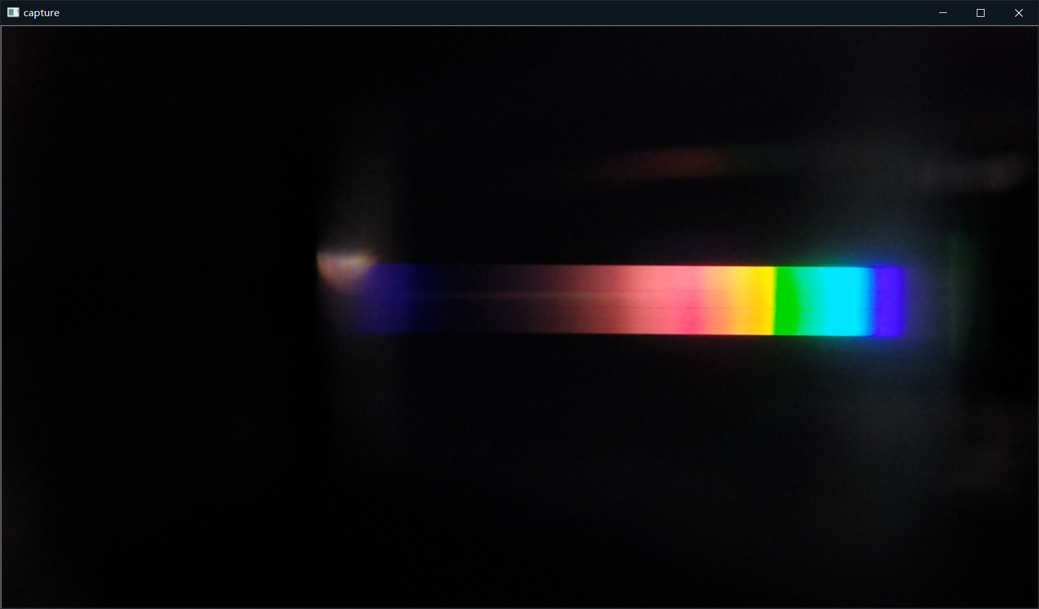



Demonstration
Notes:
Due to the time limit, here I only use the flow chart to demonstrate how to use this spectrometer. We firstly connect the spectrometer to the computer, open the software, and put the input window of the spectrometer to the light source. Then the live video of the spectrum image will be showing on the screen, and if we press the Enter key, the program will process the image data and show the spectrum diagram on the screen. And then the image of the spectrum and the spectrum diagram will be saved to the local disk.

Slide 29




Result
Measurement of Different Light Sources
3 type of Laser, Mercury Lamp, Sodium Lamp, etc.
Notes:
To validate this project, I use different light sources to test the spectrometer.

Slide 30




Result
Notes:
In the result, I put the spectrum image on the top and the diagram of spectra on the bottom.

Slide 31




Result

Slide 32




Result

Slide 33




Result
Notes:
In the spectra diagram of sunlight, we could see the wavelength range of this spectrometer is around 350 to 950 nm.

Slide 34


Result
D-lines of Sodium (588.9 and 589.5 nm)
$Resolution<0.6 nm <1 nm$
Notes:
Then if we zoom in the sodium lamp spectra diagram, we could see two yellow spikes around the 590 nm, they are the D-lines of the sodium emission spectrum. This indicates the resolution is less than 0.6 nm.

Slide 35
Conclusion
The spectrometer achieves the 0.6 nm resolution
The total cost is about 1200 CNY
The wavelength range is around 350-950 nm
An easy-to-use software is built.
All the material is open-sourced in my Github Repository:
https://github.com/szl0834
In conclusion, the project satisfied the design goals.

Slide 36
Future Works
Using standard luminance light source as the reference to mapping the relative luminance to the physical luminous flux value.
Notes:
For the future work, we could use a standard luminance light source or a luminometer to calibrate it into the physical luminance value. However, these equipment are usually expensive, so that I did not include it in this project.

Slide 37
Reference
[1] | Wasatch Photonics., "What Are the Types of Diffraction Gratings?," [Online]. Available: https://wasatchphotonics.com/technologies/types-diffraction-gratings/. [Accessed 7 5 2021].
[2] | C. Zhang, S. Ashwinlal and J. Comins, "Spectral Ray Tracing," [Online]. Available: https://ceciliavision.github.io/graphics/a6/. [Accessed 7 5 2021].
[3] | "The Human Visual System," [Online]. Available: http://what-when-how.com/display-interfaces/the-human-visual-system-display-interfaces-part-1/. [Accessed 7 5 2021].
[4] | D. Tim, "Tomographic reconstruction of combined tilt- and focal series in scanning transmission electron microscopy," ResearchGate, 1 2015.
[5] | BenRG, "CIE 1931 xy color space diagram," 24 09 2009. [Online]. Available: https://commons.wikimedia.org/wiki/File:CIExy1931.png. [Accessed 20 04 2021].
Notes:
And here is the reference about the picture that I used in this slides.

Slide 38
Thanks for Listening

